Slide 1
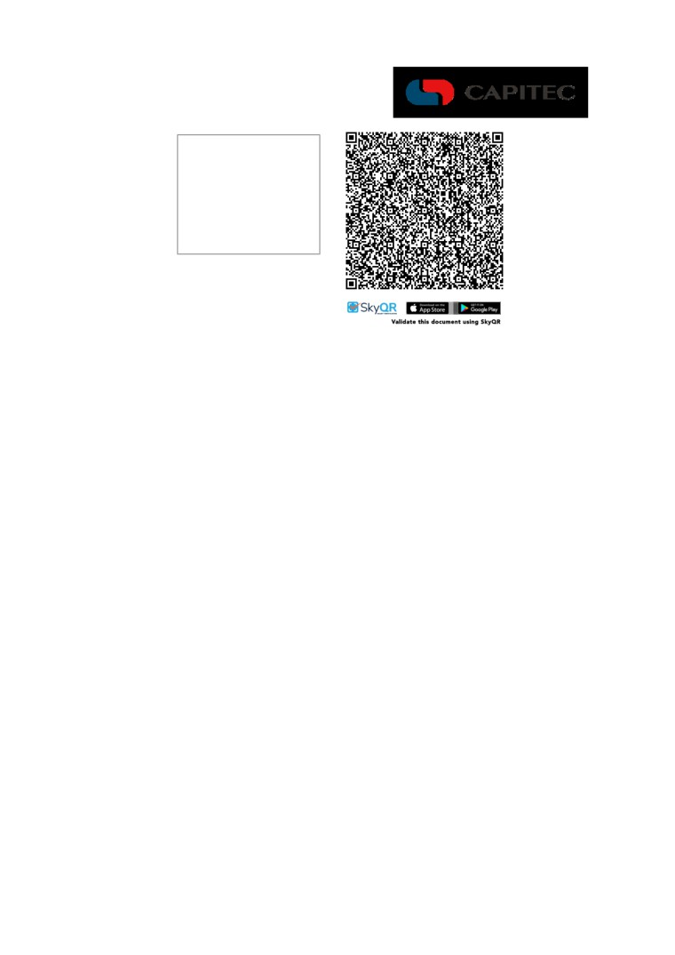
One of the Global One money management products or services
Proof of Account Details
Capitec Bank
19/09/2025
Branch: 470010 Device: 9003
To Whom it May Concern
We hereby confirm that Malibongwe Mkela has the following account(s) at Capitec Bank Limited on 19/09/2025
Client Details
Name:
Malibongwe Mkela
ID/Passport Number:
8202035872088
Address:
9 NEELS STREET, LAMBTON GARDENS, GERMISTON, JOHANNESBURG, 1401
Postal Address:
9 NEELS STREET, LAMBTON GARDENS, GERMISTON, JOHANNESBURG, 1401
Account Details
Account Status:
Active
Account Type:
Savings
Account Number:
1247811989
Bank Name:
Capitec
Branch Code:
470010
Date Opened:
2010-12-28
The account details provided herein should not be read as extending by implication to any other matters not specifically addressed. The account details are given as at the above date and no obligation is hereby assumed to update the account details on any future date.
Capitec Bank Limited shall have no liability whether in contract, delict (including without limitation negligence) or otherwise to the above accountholder or any third party in relation to the account details contained herein.
24hr Client Care Centre 0860 10 20 43 E ClientCare@capitecbank.co.za capitecbank.co.za
Capitec Bank is an authorised financial services (FSP46669) and registered credit provider (NCRCP13). Capitec Bank Limited Reg. No.: 1980/003695/06. Page 1 of 1
Unique Document No.: 0a9830bb-5855-4a47-a31b-5bf47be74653 / 406 / V4.0 - 14/04/2018 (ddmmccyy)

